Slide 1
POSLOVNA INTELIGENCA + INTELIGENCA
Prof. dr. Matjaž Gams

Slide 2
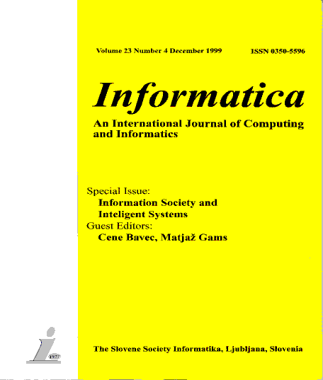
ZDRUŽENJA
ACM Slovenia, SLAIS, DKZ, IAS, Informatika
http://dis-slovarcek.ijs.si/ (računalniški slovarček) 12.000 gesel
Avatarji – IJS http://www.ijs.si/, MOL http://www.ljubljana.si/si/mol/
Informatica
Med najbolj citiranimi slovenskimi revijami po Google, Scopus etc.
JSI rast – E9, E8, E3 …Naš sedaj 35 members
Soustanovil ACM Slo, SLAIS, DKZ, IAS
Najboljša aplikacija: zaposlovalni agent prvi v svetu preko 90% vseh
Letos odsek 5 nagrad, najboljše sodelovanje z gospodarstvom, drugo na inovacijah ...

Slide 3
DEFINICIJE INTELIGENCE
Intelligence has been defined in different ways, including the abilities for abstract thought, understanding, communication, reasoning, learning, planning, emotional intelligence and problem solving.
Intelligence is most widely studied in humans, but has also been observed in animals and plants.
Artificial intelligence is the intelligence of machines or the simulation of intelligence in machines.
Numerous definitions of and hypotheses about intelligence have been proposed since before the twentieth century, with no consensus reached by scholars.

Slide 4
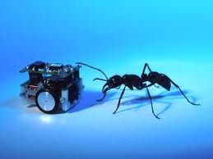
DEFINICIJE INTELIGENCE
Ali obstaja univerzalna definicija inteligence?
Naravna inteligenca / ljudje, živali, rastline
Umetna inteligenca
Inženirska inteligenca
Poslovna inteligenca

Slide 5
DEFINICIJE UMETNE INTELIGENCE
Wikipedia: Artificial intelligence (AI) is the intelligence of machines and the branch of computer science that aims to create it.
AI textbooks define the field as "the study and design of intelligent agents"[2] where an intelligent agent is a system that perceives its environment and takes actions that maximize its chances of success.
[3] John McCarthy, who coined the term in 1956,[4] defines it as "the science and engineering of making intelligent machines."[5]
(Artificial intelligence has been the subject of breathtaking optimism, has suffered stunning setbacks and is today an essential part of the technology industry, computer science and IS.)

Slide 6
ARTIFICIAL INTELLIGENCE
Russell and Norvig ARTIFICIAL INTELLIGENCE: A Modern Approach

Slide 7
DEFINICIJA INTELIGENTNIH SISTEMOV
Intelligent system is a system that learns during its existence.
It senses its environment and learns, for each situation, which action permits it to reach its objectives.
It continually acts, mentally and externally, and by acting reaches its objectives.
To reach its objective it has to select its response. A simple way to select a response is to select one that was favorable in a similar previous situation.

Slide 8
LASTNOSTI INTELIGENTNIH SISTEMOV
Učenje
Fleksibilnost
Prilagajanje
Razlaga
Odkritje

Slide 9
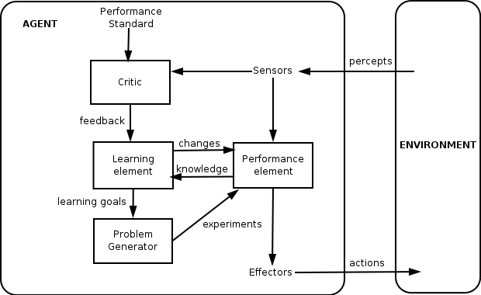
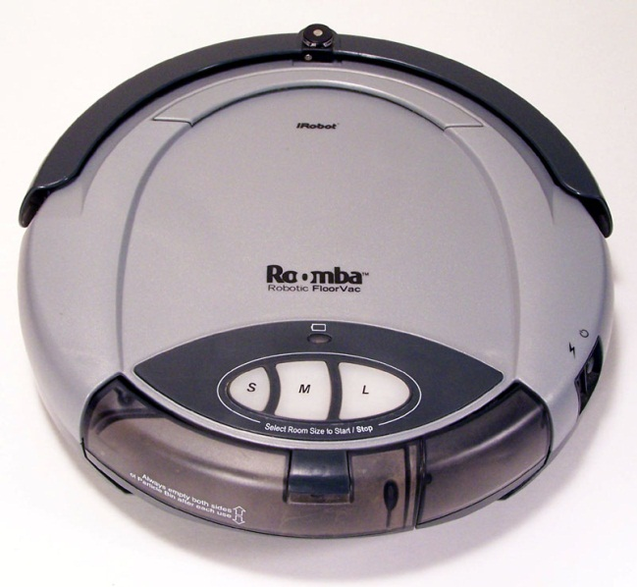
DEFINICIJE INTELIGENCE
Definition: An intelligent entity is capable of learning. What learns is intelligent.
An intelligent entity is an intelligent system.
Engineering definition: More advanced than current classical solutions (may not learn).
According to Wikipedia: A thermostat is an intelligent agent.
Our definition: an intelligent agent learns.
An intelligent agent without learning is just an agent.

Slide 10
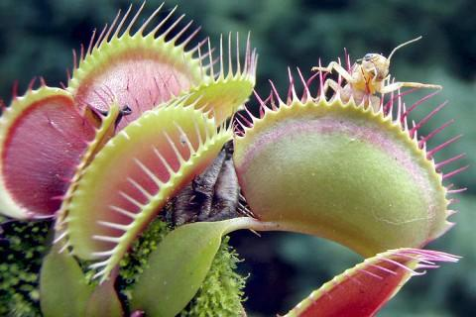
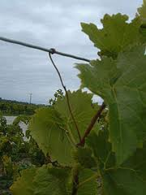
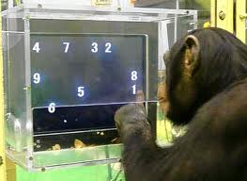
NARAVNA INTELIGENCA
Humans, animals, plants?
Are viruses intelligent?
All beings are!
Different levels of intelligence.
Sort dogs by intelligence.
Do animals really think?
Tools (birds, apes)
Joy, empathy, greed (apes, orkas, elephants, pigs)
Are animals getting smarter?
(humans + aliens?) (interactions with humans, wash food, crash walnuts)
Notes:
muholovka

Slide 11
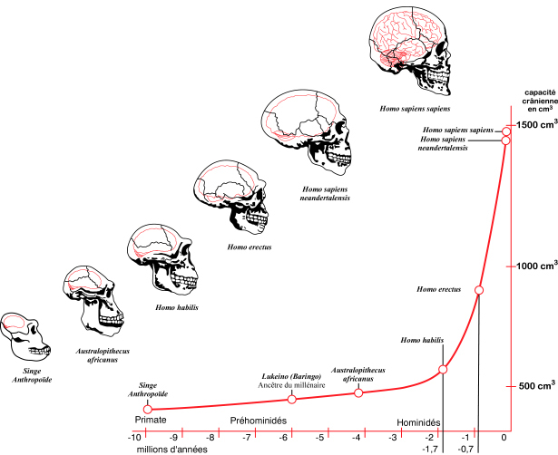
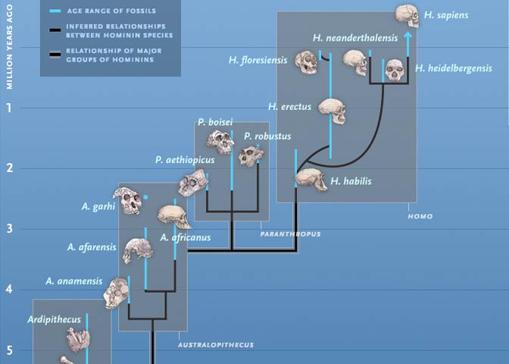
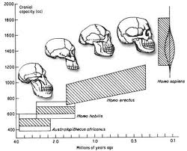
ČLOVEŠKA INTELIGENCA
Intelligence = better predictions, better reaction. More energy consumption – 25%.
Sexual attraction? Anthropological principle.
Tool evolution?

Slide 12
„MALI LJUDJE“
Scientists have discovered a tiny species of ancient human that lived 18,000 years ago on an isolated island east of the Java Sea -- a prehistoric hunter in a "lost world" of giant lizards and miniature elephants.
These "little people" stood about three feet tall (1 m) and had heads the size of grapefruit. They coexisted with modern humans for thousands of years yet appear to be more closely akin to a long-extinct human ancestor.
Prebivalci okoliških vasi pripovedujejo zgodbe o teh „malih ljudeh“, ki so živeli v pečinah. Ženske so metale prsi čez rame. Ker so jim kradli otroke, so se njihovi predniki enkrat razjezili in jih požgali.

Slide 13
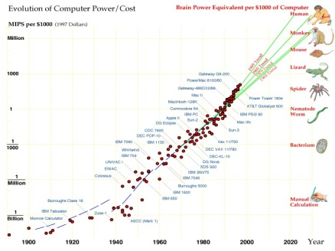
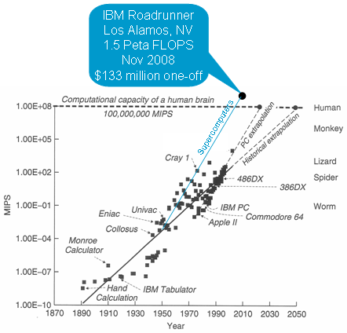
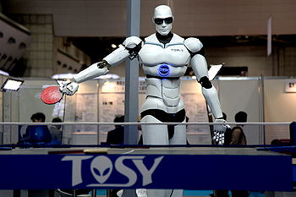
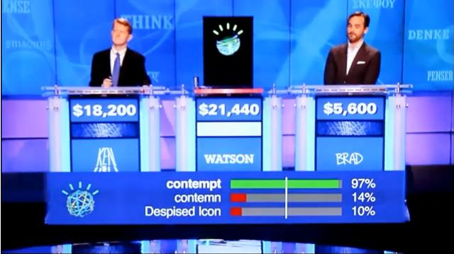
TRENDI RAČUNALNIKOV
Chess, JEOPARDY …

Slide 14
ČLOVEŠKE IN RAČUNALNIŠKE SPOSOBNOSTI
Moč procesiranja
Računalniki
Ljudje
Čas

Slide 15
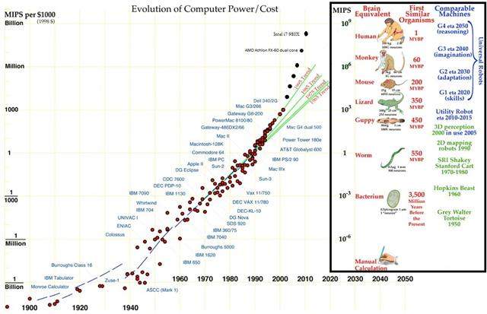
ČLOVEŠKE IN RAČUNALNIŠKE SPOSOBNOSTI

Slide 16
d
ČLOVEŠKA IN RAČUNALNIŠKA RAST
Flynn
Ljudje + Računalniki = Informacijska družba
Moč procesiranja
Računalniki
Ljudje
Čas

Slide 17
ČLOVEŠKA IN RAČUNALNIŠKA RAST
Ljudje + Računalniki = Informacijska družba
Moč procesiranja
Kurtzweil
Računalniki
Ljudje
Čas

Slide 18
ČLOVEŠKA INTELIGENCA IN RAČUNALNIŠKA
Unknown barrier

Slide 19
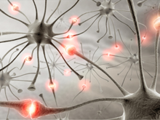
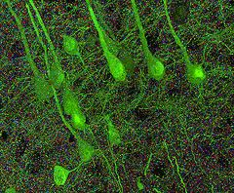
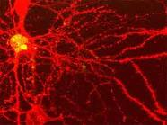
NEURON
Connected to 10.000 each, a switch? Stanford 2010: … the brain’s overall complexity is almost beyond belief, said Smith. “One synapse, by itself, is more like a microprocessor —with both memory-storage and information-processing elements — than a mere on/off switch. In fact, one synapse may contain on the order of 1,000 molecular-scale switches. A single human brain has more switches than all the computers and routers and Internet connections on Earth,” he said.
…neuroscientists uncovered strong evidence that neurons also communicate with each other through weak electric fields. The study, published in the journal Nature Neuroscience, by Dr Costas Anastassiou (Caltech), explains how every time an electrical impulse races down the branch of a neuron, a tiny electric field surrounds that cell ..
Drake equation

Slide 20
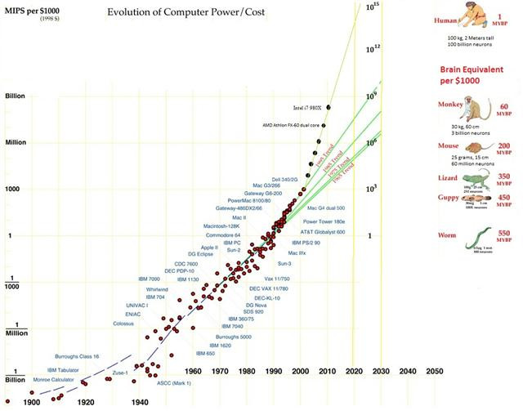
ČLOVEŠKE IN RAČUNALNIŠKE SPOSOBNOSTI

Slide 21
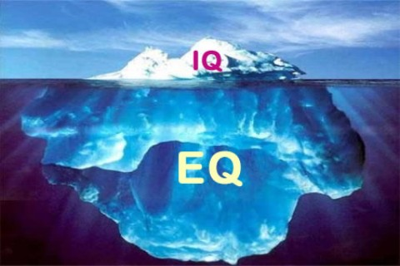
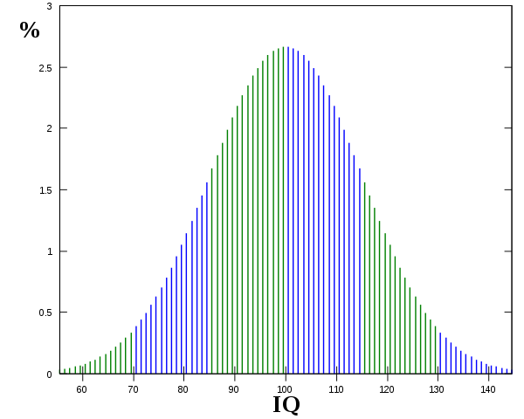
ČLOVEŠKA INTELIGENCA
10-30 vrst inteligence: splošna, simbolična, emocionalna, abstraktna, gibalna, vidna, govorna, bralna, glasbena ….
Emotional intelligence (EI) is a skill or ability in the case of the trait EI model, a self-perceived ability to identify, assess, and control the emotions of oneself, of others, and of groups. Various models and definitions have been proposed of which the ability and trait EI models are the most widely accepted in the scientific literature. Criticisms have centered on whether the construct is a real intelligence and whether it has incremental validity over IQ and the Big Five personality dimensions.
Flynnov effect / pametnejši ljudje imajo manj otrok
IQ testi: splošni, specialni, integralni …

Slide 22
ČLOVEŠKA INTELIGENCA
IQ is the best single predictor of success at job. People with higher IQ have higher title, status, income, live longer and healthier. And vice versa.
(W: individuals with low IQs are more likely to be divorced, have a child out of marriage, be incarcerated, and need long-term welfare support).
Kako je to mogoče?
Svet ljudje vidijo na raznih nivojih! (politično, popularno, ljudske mase, poslovno, mediji, poljudno-znanstveno, znanstveno)
Znanost – dejstva, empirično preverjanje, platonizem
Inženirji – konstrukcija, delovanje naprav in sistemov
Poslovni pogled – kako narediti dober posel

Slide 23
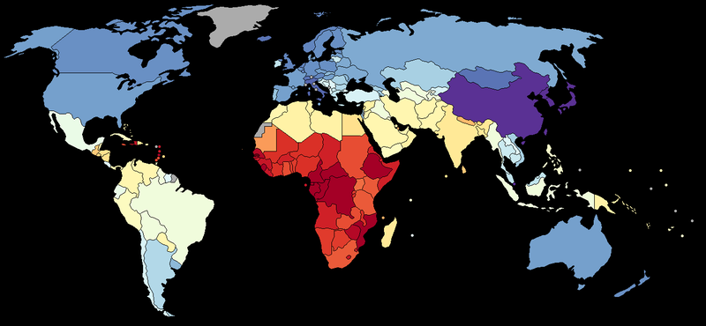
ČLOVEŠKA INTELIGENCA
DISTRIBUCIJA: veliki/mali, M/Ž, religiozni, glede na iskalnik … male ali pomembne razlike? Sobotna priloga 12.3.2011 Resetiranje v 23 tezah

Slide 24
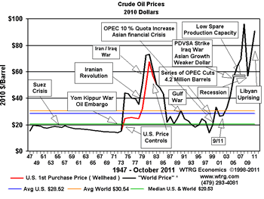
UPORABA INTELIGENCE ZA ANALIZE IN NAPOVEDI
Primer, kako lahko uporabimo inteligentne sisteme za konkretne zaključke - nafta
Maksimalna produkcija 10-20 let
Cene skačejo gor in dol
Ni zanesljivih kratkoročnih napovedi
Ali lahko napovedujemo z inteligentnimi sistemi?
GAMS, Matjaž. "Inteligentno" napovedovanje cen nafte : umetna inteligenca in inteligentni sistemi. Delo (Ljubl.), 2.9.2004, str. 18, Znanost. [COBISS.SI-ID 18432295]

Slide 25
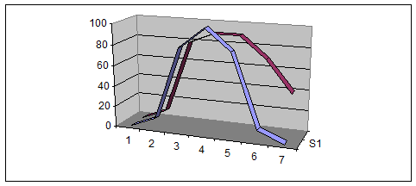
LAHKO NAPOVEMO PRIHODNOST? Konec poceni nafte – bo draga zelo ali precej. Cena nafte slabo vpliva na razvoj človeške civilizacije. Iskanje nadomestkov poveča ceno hrane. Praktične posledice: Kakšno ogrevanje osebno, kakšno v državi, kakšno izolacijo … Ločevanje odpadkov, sončno ogrevanje v Ljubljani pozimi? Kako bi še uporabili inteligenco za izboljšanje življenja (stroški …)?

Slide 26
LAHKO NAPOVEMO PRIHODNOST? Robert Merton, Social Theory and Social Structure, self fulfilling prophecy, banka Millingville, 1949, (Merton system: inteligentni sistem: tandem človek-računalnik) Peter F. Drucker: The best way to predict is to predict the future is to make it. Najbolj uspešen način napovedovanja prihodnosti je, da jo narediš. Herbert A. Simon: Bounded rationality: agents have limited knowledge (information and cognitive) to optimize their expected benefits; behavioral economics; Nobel Prize for decision making in economy, Turing award for AI Ronald Heiner: theory of predictable behavior: since agents (humans) cannot optimize well due to lack of info and cognitive skills, they use rules and thus their performance is predictable

Slide 27
DEMOGRAFIJA - RODNOST
World (Pearce)
Stable fertility 2.1 (developed) – 2.3 (world)
1950 fertility 5 – 6
1970 3.9
2000 2.8
2007 2.6 (Pearce)
Now 2.5 (National Geographic)
Brasilia (National Geographic)
1960 1970 1980 1990 2000 2009
6.3 5.8 4.4 2.7 2.4 1.9
Dva pomembna faktorja: liberalizacija žensk (destrukcija družin), telenovele (seks v mestu)

Slide 28
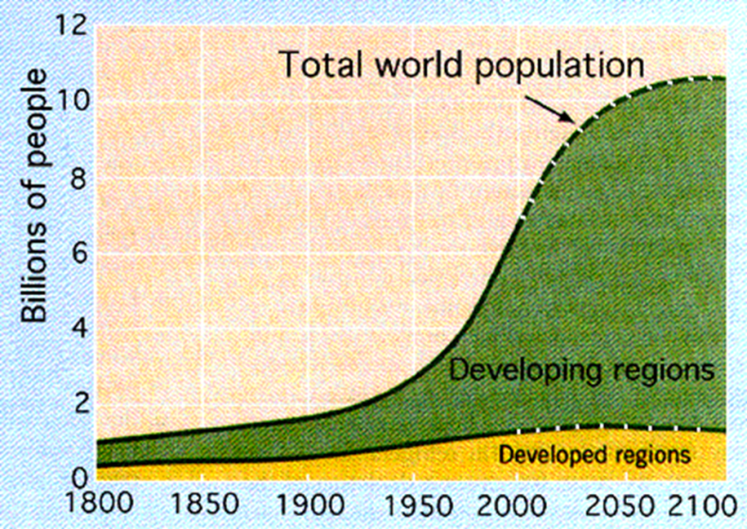
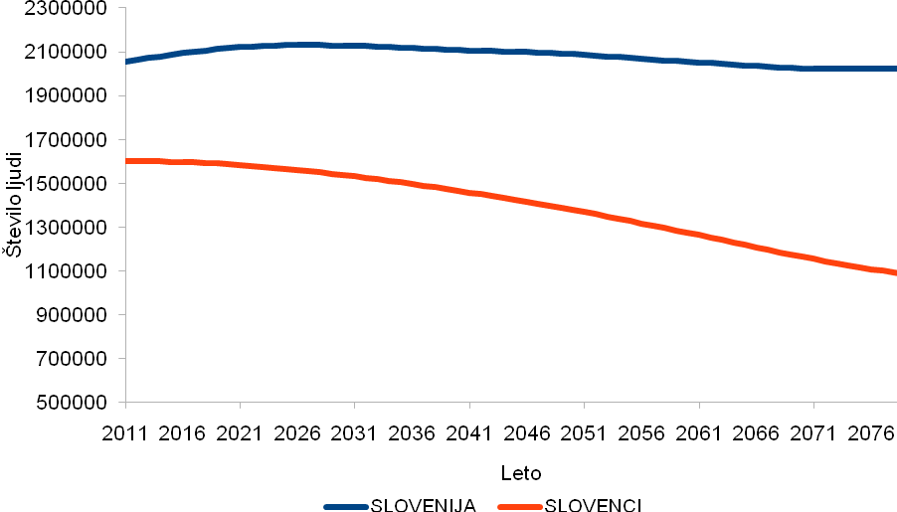
DEMOGRAFIJA World: With fertility 2.5 and falling, growth to 10, then ??; fast growth only in sub-Saharan Africa Europe: European demographic winter – relations similar to Slovenia Slovenia: Seemingly no problems in Slovenia due to high migration, in reality very low fertility leading to extinction of Slovenians Predictions: World populations will grow fast due to time delay – but is close to sustainable fertility Slovenia: extinction or not depends on our information and will Pension reform is urgent and is caused by longer living +9 hours in 24
Starost
Moški

Slide 29
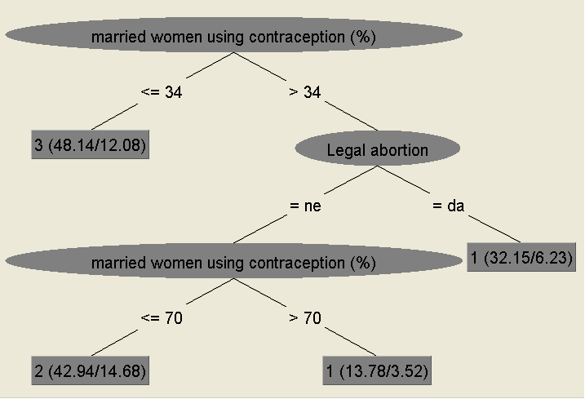
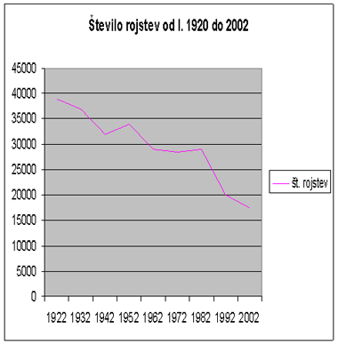
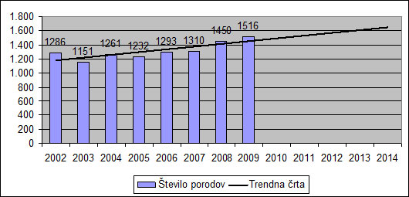
DEMOGRAFIJA
S splošnimi metodami ML in DM
Boljše analize kot eksperti (kot šah)
Praktične posledice:
Zavedanje problema (izumrtje, finance, šolstvo …)
Izboljšanje družinskega statusa
Nujnost pokojninske reforme

Slide 30
KATEREMU DREVESU ZAUPATI?
Given data and the constructed tree,
Can it be trusted? Can it be verified?
Can it be improved?
Different statistical measures (kappa …)
Design trees under different parameters
Adapt some algorithmic approach
IMPACT OF HIGH-LEVEL KNOWLEDGE ON ECONOMIC WELFARE THROUGH INTERACTIVE DATA MINING, Applied Artificial Intelligence: An International Journal
Volume 25, Issue 4, 2011, Pages 267 - 291
Authors: Vedrana Vidulinª; Matja Gamsª
Science: funds (comp., pat., women, technicians, govern.)
Education: mobility and % of students, several more

Slide 31
DISKUSIJA
Kaj je inteligenca?
Kaj je znanstveno in kaj ni?
Višji nivo razumevanja
Znanje in inteligenca omogočata boljše napovedovanje in delovanje

